Slide 1
A Case for NUMA-aware Contention Management on Multicore Systems Sergey Blagodurov et al, USENIX ATC 2011

Slide 2
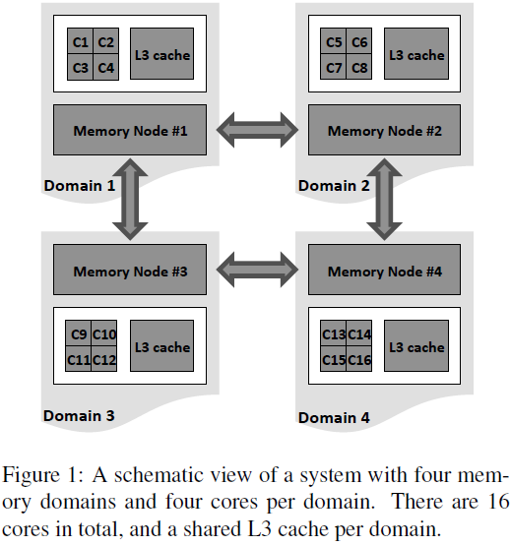
A NUMA System
There are multiple memory nodes, one per memory domain
Local nodes can be accessed in less time than remote ones, and each node has its own memory controller.
Notes:
Suppose that two competing threads A and B
run on cores C1 and C2 on a system shown in Figure 1.
A contention-aware scheduler would detect that A and
B compete and migrate one of the threads, for example
thread B, to a core in a different memory domain, for example
core C5. Now A and B are not competing for the
last-level (L3) cache, and on UMA systems this would be
sufficient to eliminate contention. But on a NUMA system
shown in Figure 1, A and B are still competing for
the memory controller at Memory Node #1 (MC in Figure
5), assuming that their memory is physically located
in Node #1. So by simply migrating thread B to another
memory domain, the scheduler does not eliminate one of
the most significant sources of contention – contention
for the memory controller

Slide 3
Thread Migration Example
Suppose that two competing threads A and B run on cores C1 and C2 on a system shown in Figure 1. A contention-aware scheduler would detect that A and B compete and migrate one of the threads, for example thread B, to a core in a different memory domain, for example core C5. Now A and B are not competing for the last-level (L3) cache, and on UMA systems this would be sufficient to eliminate contention. But on a NUMA system shown in Figure 1, A and B are still competing for the memory controller at Memory Node #1 (MC in Figure 5), assuming that their memory is physically located in Node #1. So by simply migrating thread B to another memory domain, the scheduler does not eliminate one of the most significant sources of contention – contention for the memory controller

Slide 4
Four sources of performance degradation that can occur on modern NUMA systems
Contention for the shared last-level cache (CA). This also includes contention for the system request queue and the crossbar.
Contention for the memory controller (MC). This also includes contention for the DRAM prefetching unit.
Contention for the inter-domain interconnect (IC).
Remote access latency, occurring when a thread’s memory is placed in a remote node (RL).
NUMA Domain 0
Core 0
Core 1
Core 2
Core 3
L1, L2 cache
L1, L2 cache
L1, L2 cache
L1, L2 cache
Shared L3 Cache
System Request Interface Crossbar switch
Memory
Controller
HyperTransport
Memory node 0
to other domains
An AMD Opteron 8356 Barcelona domain
-4-

Slide 5
An AMD Opteron system with 4 domains
Core 0
Core 4
Core 8
Core 12
Core 3
Core 7
Core 11
Core 15
NUMA Domain 0
L1, L2 cache
L1, L2 cache
L1, L2 cache
NUMA Domain 1
L1, L2 cache
L1, L2 cache
L1, L2 cache
L1, L2 cache
L1, L2 cache
Shared L3 Cache
Shared L3 Cache
MC
HT
HT
MC
Memory node 0
Memory node 1
Memory node 2
Memory node 3
MC
HT
HT
MC
Shared L3 Cache
Shared L3 Cache
L1, L2 cache
L1, L2 cache
L1, L2 cache
L1, L2 cache
L1, L2 cache
L1, L2 cache
L1, L2 cache
L1, L2 cache
NUMA Domain 2
NUMA Domain 3
Core 2
Core 6
Core 10
Core 14
Core 1
Core 5
Core 9
Core 13
-5-

Slide 6
Contention for the shared last-level cache (CA)
Core 0
Core 4
Core 8
Core 12
Core 3
Core 7
Core 11
Core 15
NUMA Domain 0
L1, L2 cache
L1, L2 cache
L1, L2 cache
NUMA Domain 1
L1, L2 cache
L1, L2 cache
L1, L2 cache
L1, L2 cache
L1, L2 cache
Shared L3 Cache
Shared L3 Cache
MC
HT
HT
MC
Memory node 0
Memory node 1
Memory node 2
Memory node 3
MC
HT
HT
MC
Shared L3 Cache
Shared L3 Cache
L1, L2 cache
L1, L2 cache
L1, L2 cache
L1, L2 cache
L1, L2 cache
L1, L2 cache
L1, L2 cache
L1, L2 cache
NUMA Domain 2
NUMA Domain 3
Core 2
Core 6
Core 10
Core 14
Core 1
Core 5
Core 9
Core 13
-6-

Slide 7
Core 0
Core 4
Core 8
Core 12
Core 3
Core 7
Core 11
Core 15
NUMA Domain 0
L1, L2 cache
L1, L2 cache
L1, L2 cache
NUMA Domain 1
L1, L2 cache
L1, L2 cache
L1, L2 cache
L1, L2 cache
L1, L2 cache
Shared L3 Cache
Shared L3 Cache
MC
HT
HT
MC
Memory node 0
Memory node 1
Memory node 2
Memory node 3
MC
HT
HT
MC
Shared L3 Cache
Shared L3 Cache
L1, L2 cache
L1, L2 cache
L1, L2 cache
L1, L2 cache
L1, L2 cache
L1, L2 cache
L1, L2 cache
L1, L2 cache
NUMA Domain 2
NUMA Domain 3
Core 2
Core 6
Core 10
Core 14
Core 1
Core 5
Core 9
Core 13
Contention for the memory controller (MC)
-7-

Slide 8
Contention for the inter-domain interconnect (IC)
Core 0
Core 4
Core 8
Core 12
Core 3
Core 7
Core 11
Core 15
NUMA Domain 0
L1, L2 cache
L1, L2 cache
L1, L2 cache
NUMA Domain 1
L1, L2 cache
L1, L2 cache
L1, L2 cache
L1, L2 cache
L1, L2 cache
Shared L3 Cache
Shared L3 Cache
MC
HT
HT
MC
Memory node 0
Memory node 1
Memory node 2
Memory node 3
MC
HT
HT
MC
Shared L3 Cache
Shared L3 Cache
L1, L2 cache
L1, L2 cache
L1, L2 cache
L1, L2 cache
L1, L2 cache
L1, L2 cache
L1, L2 cache
L1, L2 cache
NUMA Domain 2
NUMA Domain 3
Core 2
Core 6
Core 10
Core 14
Core 1
Core 5
Core 9
Core 13
-8-

Slide 9
Remote access latency (RL)
A
Core 3
Core 7
Core 11
Core 15
Core 0
Core 4
Core 8
Core 12
NUMA Domain 0
L1, L2 cache
L1, L2 cache
L1, L2 cache
NUMA Domain 1
L1, L2 cache
L1, L2 cache
L1, L2 cache
L1, L2 cache
L1, L2 cache
Shared L3 Cache
Shared L3 Cache
MC
HT
HT
MC
Memory node 0
Memory node 1
Memory node 2
Memory node 3
MC
HT
HT
MC
Shared L3 Cache
Shared L3 Cache
L1, L2 cache
L1, L2 cache
L1, L2 cache
L1, L2 cache
L1, L2 cache
L1, L2 cache
L1, L2 cache
L1, L2 cache
NUMA Domain 2
NUMA Domain 3
Core 2
Core 6
Core 10
Core 14
Core 1
Core 5
Core 9
Core 13
-9-

Slide 10
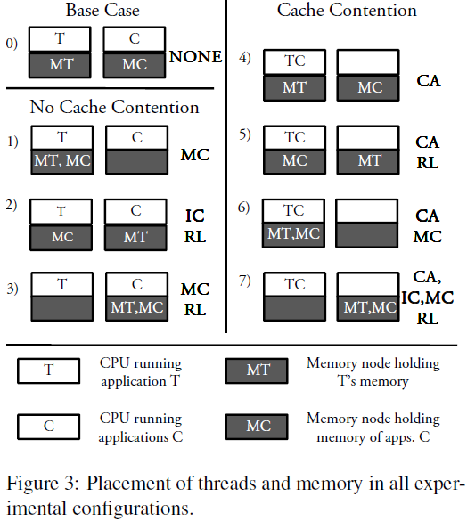
Placement of Threads and Memory
We run a target application, denoted as T with a set of three competing applications, denoted as C. The memory of the target application is denoted MT, and the memory of the competing applications is denoted MC.
CA: Cache contention
MC: Memory Controller
IC: Interconnect
RL: Remote Latency

Slide 11
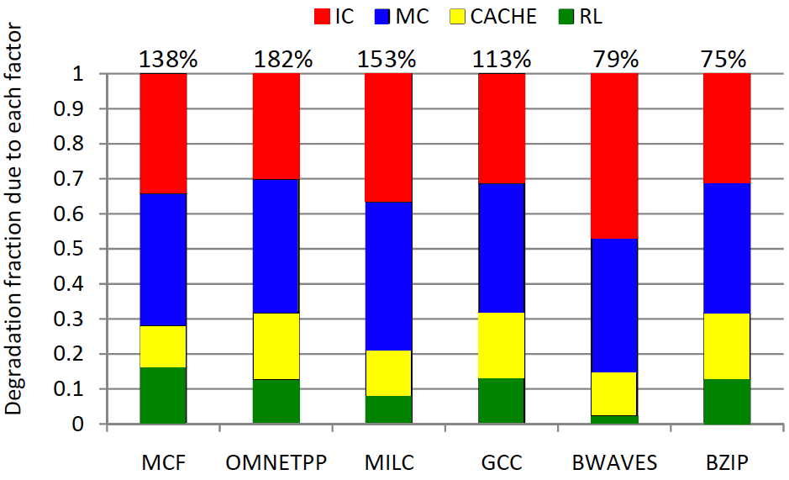
Memory Controller (MC) and Interconnect (IC) contention are key factors hurting performance
Dominant degradation factors
-11-

Slide 12
Characterization method
Given two threads, decide if they will hurt each other’s performance if co-scheduled
Scheduling algorithm
Separate threads that are expected to interfere
A
B
A
B
Contention-Aware Scheduling
-12-

Slide 13
Limited observability
We do not know for sure if threads compete and how severely!
Trial and error infeasible on large systems
Can’t try all possible combinations
Even sampling becomes difficult
A good trade-off: measure LLC Miss rate!
Threads interfere if they have high miss rates
No account for cache contention impact
Characterization Method
-13-

Slide 14
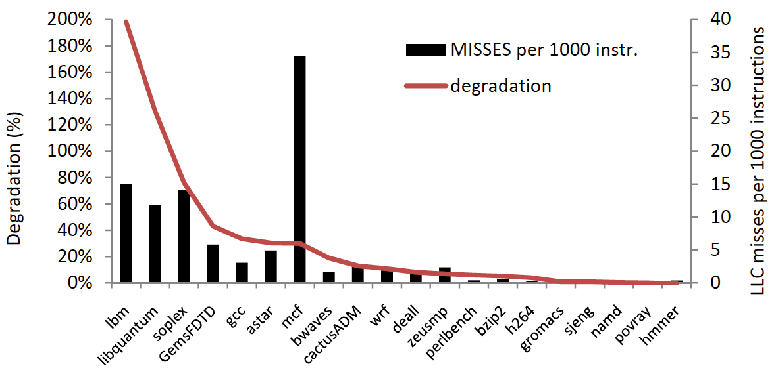
Miss rate as a predictor for contention penalty
-14-

Slide 15
Sort threads by LLC missrate:
A
B
C
D
W
X
Y
Z
Goal: isolate threads that compete for shared resources
and pull the memory to the local node upon migration
A
B
W
X
A
X
W
B
C
D
Y
Z
Y
D
C
Z
MC
HT
MC
HT
A
C
B
D
MC
HT
MC
HT
Memory
node 1
Memory
node 2
Memory
node 1
Memory
node 2
Domain 1
Domain 2
Domain 1
Domain 2
Migrate competing threads along with memory to different domains
Server-level scheduling
-15-
Notes:
On NUMA systems you must migrate both threads and memory
Clavis is the contention-aware scheduling daemon for NUMA systems that:
migrates the memory along with the application
eliminates excessive migrations by trying to keep the workload on their old nodes, if possible
utilizes Instruction Based Sampling to perform partial memory migration of “hot” pages

Slide 16
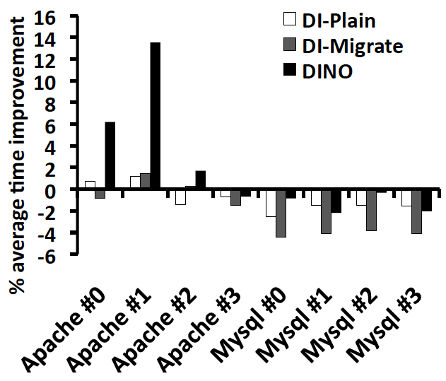
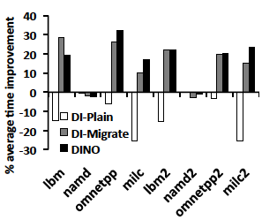
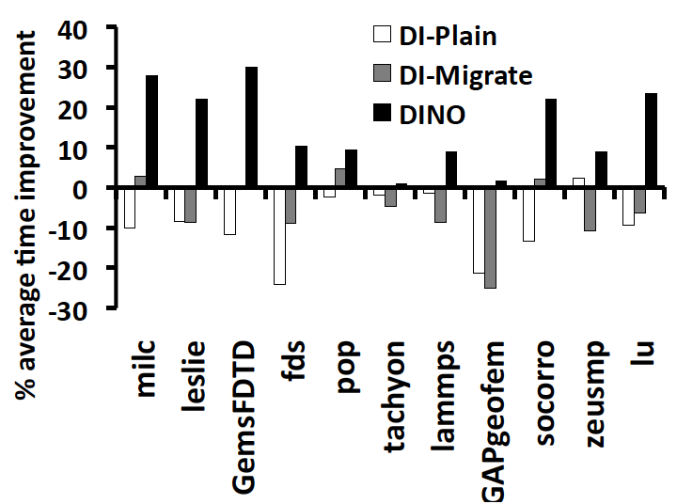
SPEC CPU 2006
LAMP
SPEC MPI 2007
Server-level results
-16-

